Slide 1

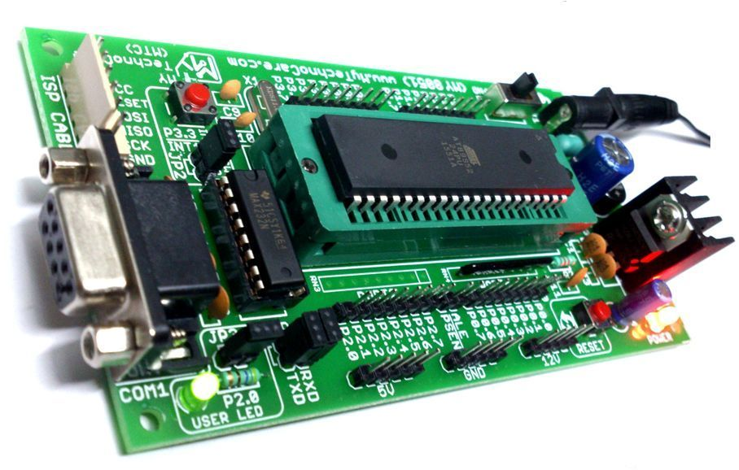
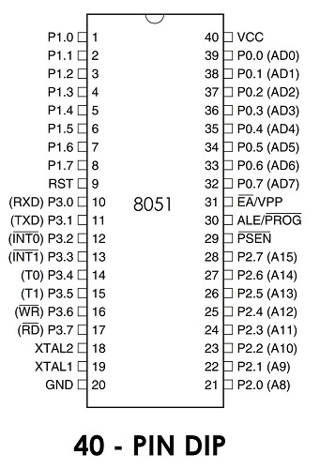
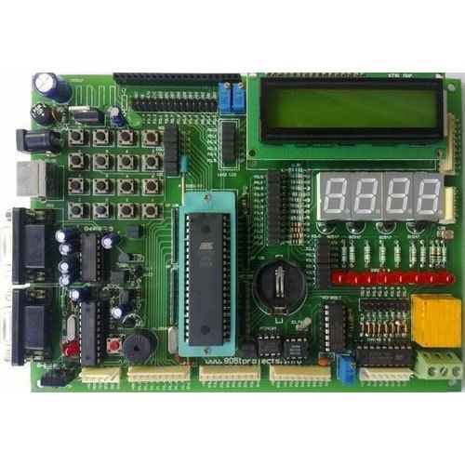
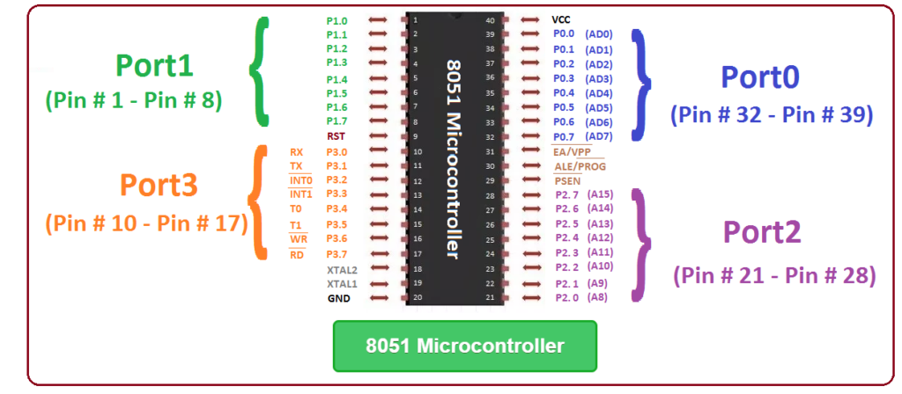
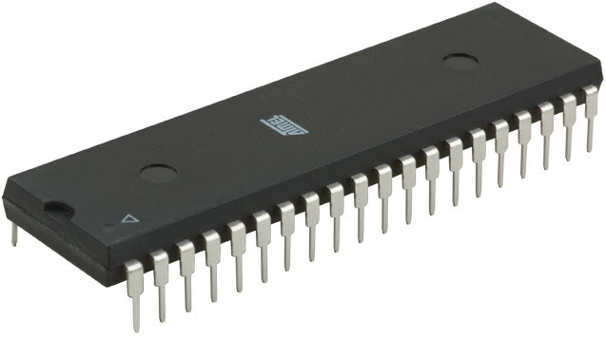
Micro Controllers – 2.2
Basics of 8051
FY – DESH – VIT
Vishwakarma Institute of Technology
FY - Department of Engineering, Sciences and Humanities

Slide 2
Mechatronics & Robotics
Vishwakarma Institute of Technology
FY - Department of Engineering, Sciences and Humanities
A quick glimpse of Microcontroller 8051

Slide 3
What do you mean by a micro-controller ?
It’s like a small computer on a single IC chip.
It contains a processor core, ROM, RAM, I/O pins, communication pins etc.
it has almost all the components needed in its single chip.
It does not need any external circuits to do its given task.
examples are …. 8051, AVR, PIC series of microcontrollers.
Vishwakarma Institute of Technology
FY - Department of Engineering, Sciences and Humanities

Slide 4
Why to study of 8051 micro-controller ?
This is the first “All in one” chip introduced by Intel in 1980 under the name MCS-51 popularly known as 8051.
It is referred as “system on a chip”. It has 128 bytes of RAM, 4K bytes of on-chip ROM, 2 timers, 1 serial port and 4 ports (8-bit wide), special function registers ….. all on one single chip.
Other variants of 8051 are 8052 and 8031.
Vishwakarma Institute of Technology
FY - Department of Engineering, Sciences and Humanities

Slide 5
Important features of 8051 micro-controller
4KB bytes on-chip program memory (ROM)
128 bytes on-chip data memory (RAM)
Four register banks
128 user defined software flags
8-bit bidirectional data bus
16-bit unidirectional address bus
32 general purpose registers each of 8-bit
16 bit Timers (usually 2, but may have more or less)
Three internal and two external Interrupts
Four 8-bit ports,(short model have two 8-bit ports)
16-bit program counter and data pointer
8051 may also have special features such as UARTs, ADC, Op-amp, etc.
Vishwakarma Institute of Technology
FY - Department of Engineering, Sciences and Humanities

Slide 6
Important terms used in a micro-controller
1) Registers –
2) Pins and Ports –
3) Oscillator, Clock, Crystal –
Vishwakarma Institute of Technology
4) Internal and External Memory –
FY - Department of Engineering, Sciences and Humanities
5) Program Counter, Data Pointer –
6) Counters and Timers –

Slide 7
Important terms used in a micro-controller
7) Address bus and Data bus –
8) Stack and Stack Pointer –
9) Flags and PSW –
Vishwakarma Institute of Technology
FY - Department of Engineering, Sciences and Humanities
10) ADC and DAC –
11) Interrupts –

Slide 8
Development board
Vishwakarma Institute of Technology
FY - Department of Engineering, Sciences and Humanities

Slide 9
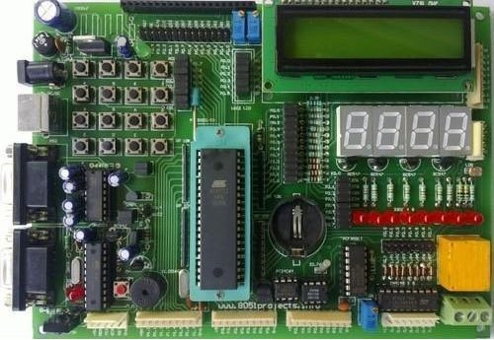
Development board
Vishwakarma Institute of Technology
FY - Department of Engineering, Sciences and Humanities

Slide 10
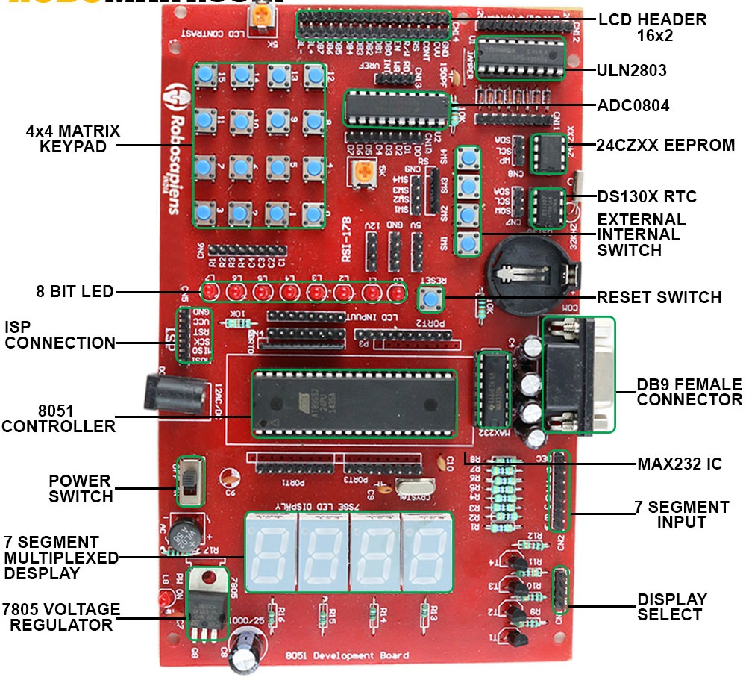
Development board
Vishwakarma Institute of Technology
FY - Department of Engineering, Sciences and Humanities

Slide 11
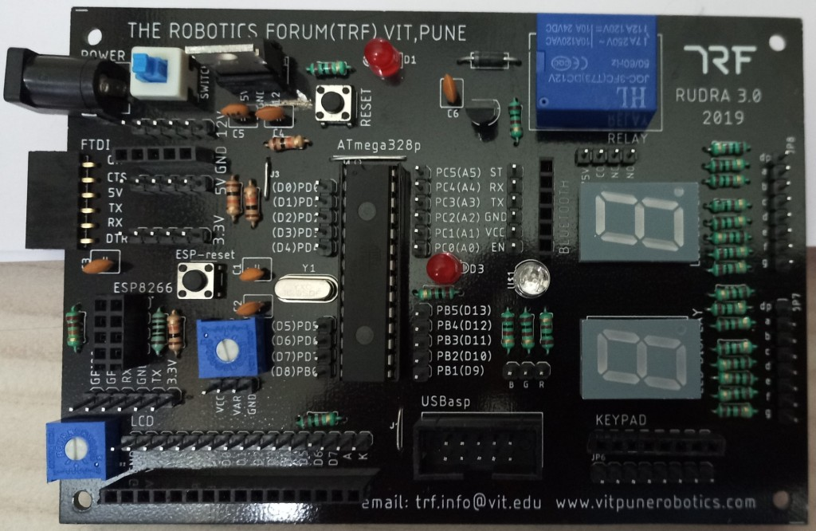
Vishwakarma Institute of Technology
FY - Department of Engineering, Sciences and Humanities

Slide 12
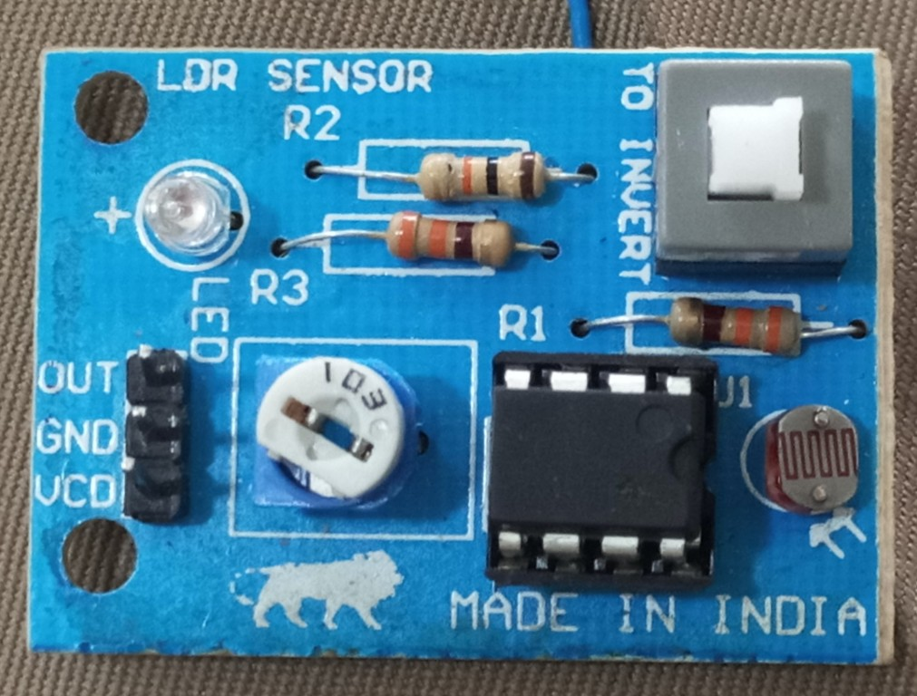
Vishwakarma Institute of Technology
FY - Department of Engineering, Sciences and Humanities

Slide 13
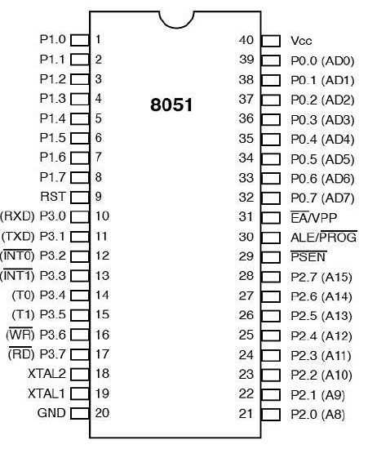
Pin diagram of 8051
Vishwakarma Institute of Technology
FY - Department of Engineering, Sciences and Humanities

Slide 14
External Interrupts
Architecture of MuC 8051
On chip 4KB ROM for program code
On chip RAM 128 Bytes
Interrupt Control
Timer 0
Counter inputs
Timer 1
CPU
Vishwakarma Institute of Technology
FY - Department of Engineering, Sciences and Humanities
Oscillator
Bus Control
4 i/o Ports
Serial Port
P0 P2 P1 P3
Address/Data Only Data
TXD RXD

Slide 15
Important terms used in a micro-controller
Registers – A register is a place in a CPU that can store small amounts of the data used for performing various operations such as addition and multiplication and loads the resulting data on main memory. Registers contain the address of the memory location where the data is to be stored.
Vishwakarma Institute of Technology
FY - Department of Engineering, Sciences and Humanities
Pins – Input and Output Pins on the MuC
Ports – Different Groups of Pins having similar or common characteristics

Slide 16
Important terms used in a micro-controller
Crystal – The basic frequency of a Quartz Crystal.
Clock – A clock generates pulses to which all internal operations are synchronised.
Oscillator – is formed by a Crystal, Capacitors and an Inverter circuit generates a train of pulses.
Vishwakarma Institute of Technology
FY - Department of Engineering, Sciences and Humanities
Internal and External Memory – Huge connections and networks of Flip-Flops are used to generate memory.

Slide 17
Important terms used in a micro-controller
Program Counter (PC) – It is a special-purpose register that is used by the processor to hold the address of the current and the next instruction to be executed. The PC has no. of bits equal to the bits required for the address of the memory location.
Data Pointer (DPTR) – Data Pointer is used for pointing to data. It is used by the 8051 to access external memory using the address indicated by DPTR.
Vishwakarma Institute of Technology
FY - Department of Engineering, Sciences and Humanities

Slide 18
Important terms used in a micro-controller
Counters and Timers –
Timer generates a time delay using the frequency of the internal clock.
Counter counts no. of pulses of an event happening outside the microcontroller.
The MuC 8051 has two counters / timers which can be used either as a Timer or as a Counter.
Vishwakarma Institute of Technology
FY - Department of Engineering, Sciences and Humanities

Slide 19
Important terms used in a micro-controller
Flags and PSW – The Flag register is the status register in a MuC that contains the current status of the MuC and indicates the status by setting or resetting a particular bit.
Flags are the bits in special function registers which generate an interrupt under specific conditions when the programmer enables them.
Vishwakarma Institute of Technology
FY - Department of Engineering, Sciences and Humanities

Slide 20
Important terms used in a micro-controller
Stack – The stack is a section of RAM used by the CPU to store a temporary information which could be a Data or an address during program execution.
Stack Pointer – The register used to access the stack is called stack pointer register which is a small register used to point at the stack.
Vishwakarma Institute of Technology
FY - Department of Engineering, Sciences and Humanities

Slide 21
Important terms used in a micro-controller
Interrupt – An interrupt is a signal to the processor emitted by h/w or s/w indicating an event that needs immediate attention.
Whenever an interrupt occurs, the controller completes the execution of the current instruction and jumps to start execution of an Interrupt Service Routine (ISR) or Interrupt Handler.
When an interrupt is generated, the processor saves its execution state and begins executing the interrupt handler.
The IVT (Interrupt Vector Table) points to the ISR to be executed.
Vishwakarma Institute of Technology
FY - Department of Engineering, Sciences and Humanities

Slide 22
Important terms used in a micro-controller
Address Bus – It is a group of wires or lines that are used to transfer the addresses of Memory or I/O devices. It is unidirectional. The width of the address bus determines the number of memory locations CPU can address.
For e.g. a system with a 16-bit address bus can address 2¹⁶ memory locations. i.e. 65536 memory locations.
Data Bus – This is used to transfer data within the Microcontroller and Memory to i/o devices. It is Bidirectional as the MuC needs to send or receive the data.
Vishwakarma Institute of Technology
FY - Department of Engineering, Sciences and Humanities

Slide 23
Important terms used in a micro-controller
ADC – Most of the sensors which sense quantities like temperature, pressure, velocity, light etc. produce voltage which is analog in nature. Therefore an ADC is used to convert the analog voltage to digital voltage so that the 8051 MuC can understand it. Chips like ADC0804 / 0808 / 0809 are interfaced with 8051 to get a digital signal.
Analog world
(Temperature / pressure etc.)
Sensor / Transducer
Vishwakarma Institute of Technology
Signal conditioning
FY - Department of Engineering, Sciences and Humanities
ADC
MuC

Slide 24
Important terms used in a micro-controller
DAC – The MuC generates o/p which is in digital form but the controlling system like a motor or hydraulic actuator requires analog signal as they don't accept digital data.
Thus, we need to used a DAC which converts digital data into equivalent analog voltage. e.g. DAC0808
Vishwakarma Institute of Technology
FY - Department of Engineering, Sciences and Humanities
Sensor
MuC
Actuator (Motor)
ADC
DAC

Slide 25
Program Status Word – PSW 8 bit Register
D7
D6
D5
D4
D3
D2
D1
D0
CY
AC
F0
RS1
RS0
OV
-
P
psw.7
psw.6
psw.5
psw.4
psw.3
psw.2
psw.1
psw.0
Vishwakarma Institute of Technology
FY - Department of Engineering, Sciences and Humanities
Program Status Word – PSW tells about the latest status of results in the ALU (Arithematic and Logic Unit) of the Accumulator.

Slide 26
Program Status Word – PSW 8 bit Register
7
6
5
4
3
2
1
0
CY
AC
F0
RS1
RS0
OV
-
P
psw0 bit
Shows Parity of result in Accumulator A ( it is count no. of 1s)
if psw0 = 0 → even parity (0,2,4,6,8)
if psw0 = 1 → odd parity (1,3,5,7)
Ex. Add
36 + C5
Vishwakarma Institute of Technology
FY - Department of Engineering, Sciences and Humanities
0011 0110
+ 1100 0101
------------------
Accumulator has 1111 1011
( P = 7 odd)
Thus, P bit will be set to 1.
Set means bit = 1
Reset means bit = 0

Slide 27
Program Status Word – PSW 8 bit Register
7
6
5
4
3
2
1
0
CY
AC
F0
RS1
RS0
OV
-
P
psw1 bit
Unused bit
Available for future use
(don’t care bit)
Vishwakarma Institute of Technology
FY - Department of Engineering, Sciences and Humanities

Slide 28
Program Status Word – PSW 8 bit Register
OV is used to detect errors in the signed arithmetic operations.
7
6
5
4
3
2
1
0
CY
AC
F0
RS1
RS0
OV
-
P
psw2 bit
Overflow bit
Set to 1 if overflow occurs in the Accumulator
In case signed numbers MSB is reserved for the sign.
Vishwakarma Institute of Technology
FY - Department of Engineering, Sciences and Humanities
If the result of an operation on signed numbers is too large, and the sign bit (MSB) is affected, then overflow is said to occur.
Overflow occurs from B06 into B07 which is MSB. This is the sign bit. Thus, OV bit is set to 1.
7
6
5
4
3
2
1
0
Accumulator

Slide 29
Program Status Word – PSW 8 bit Register
7
6
5
4
3
2
1
0
CY
AC
F0
RS1
RS0
OV
-
P
psw3 and psw4 bit
Two bits for Selection of Register Bank
psw 4 psw3 Register Bank Location
0 0 B0 00 – 07 H
0 1 B1 08 – 0F H
1 0 B2 10 – 17 H
1 1 B3 18 – 1F H
Vishwakarma Institute of Technology
FY - Department of Engineering, Sciences and Humanities

Slide 30
Program Status Word – PSW 8 bit Register
7
6
5
4
3
2
1
0
CY
AC
F0
RS1
RS0
OV
-
P
Vishwakarma Institute of Technology
psw5 bit
User defined bit
General purpose
(don’t care bit if not defined)
FY - Department of Engineering, Sciences and Humanities

Slide 31
Program Status Word – PSW 8 bit Register
7
6
5
4
3
2
1
0
CY
AC
F0
RS1
RS0
OV
-
P
23+ 6E = ??
= 91
psw6 bit
Auxiliary Carry bit
If there occurs a carry from bit 3 to bit 4 in Accumulator, then this bit is set to 1
(lower nibble to higher nibble of A)
0010 0011
+ 0110 1110
------------------
Vishwakarma Institute of Technology
FY - Department of Engineering, Sciences and Humanities
Accumulator has 1001 0001
7
6
5
4
3
2
1
0
Accumulator
Thus AC bit is set to 1

Slide 32
Program Status Word – PSW 8 bit Register
7
6
5
4
3
2
1
0
CY
AC
F0
RS1
RS0
OV
-
P
psw7 bit
Carry Flag bit
This bit is set to 1 if there occurs a carry out from bit D7 in the A during calculations.
F3+ 6E = ??
= 161
1111 0011
+ 0110 1110
------------------
Vishwakarma Institute of Technology
FY - Department of Engineering, Sciences and Humanities
Accumulator has 1 0110 0001
9th bit !
CY bit is set to 1.

Slide 33
Program Status Word – Each bit of PSW is called as a Flag.
Four of the flags are conditional flags, which means that they indicate a condition which results after an instruction is executed. (D0, D2, D6, D7 – Parity, Overflow, Aux. Carry and Carry)
Two can be selected by the user (D3 and D4 – Register Banks)
Two are unused (D1 and D5 – Don’t care bits)
Vishwakarma Institute of Technology
FY - Department of Engineering, Sciences and Humanities

Slide 34
Example - Find status of different bits if the PSW has B3 in it.
B 3
1 0 1 1 0 0 1 1
CY
AC
F0
RS1
RS0
OV
-
P
Vishwakarma Institute of Technology
1) P = 1 ∴ Odd parity in Accumulator
2) OV = 0 ∴ No overflow into MSB in Accumulator
3) RS1 = 1 and RS0 = 0 ∴ Register Bank RB2 is selected
4) AC = 0 ∴ No carry from lower nibble to higher nibble in Accumulator
5) CY = 1 ∴ 9th bit is generated outside the 8 bit Accumulator
FY - Department of Engineering, Sciences and Humanities
What about B1 ?
What about 93 ?

Slide 35
8051 has a total of 21 special function registers
(SFRs)
Timer Registers – 6 nos.
TH0, TH1, TL0 and TL1 – Timer High and Timer Low Reg.
TCON – Timer Control Reg.
TMOD – Timer Mode Reg.
Vishwakarma Institute of Technology
FY - Department of Engineering, Sciences and Humanities
Main – 2 nos.
A – Accumulator - Math, Logical, Data manipulation
B – Extension (support Acc. for temporary storage )

Slide 36
8051 has a total of 21 special function registers
(SFRs)
P0, P1, P2 and P3 – Store i/o port data – 4 nos.
PSW – Program Status Register – 1 no.
Serial Registers – 2 nos.
SCON – Serial Port Control Register
SBUF – Serial Buffer Data Register
Vishwakarma Institute of Technology
FY - Department of Engineering, Sciences and Humanities

Slide 37
8051 has a total of 21 special function registers
(SFRs)
SP – Stack Pointer – for internal RAM stack – 1 no.
DPTR (DPH and DPL) – Data Pointer Register – 2 nos.
PCON – Power Control Register – 1 no.
Vishwakarma Institute of Technology
FY - Department of Engineering, Sciences and Humanities
IE – Interrupt Enable Control Register – 1 no.
IP – Interrupt Priority Control Register – 1 no.

Slide 38
External Interrupts
Architecture of MuC 8051
On chip ROM for program code
ETC
Interrupt Control
Timer 0
Counter inputs
On chip RAM
Timer 1
CPU
Vishwakarma Institute of Technology
FY - Department of Engineering, Sciences and Humanities
Oscillator
Bus Control
4 i/o Ports
Serial Port
P0 P2 P1 P3
Address/Data Only Data
TXD RXD

Slide 39
Pin diagram of Intel’s 8051
MuC
Vishwakarma Institute of Technology
FY - Department of Engineering, Sciences and Humanities

Slide 40
Port Configuration of 8051
Port 0 – Pins 32 to 39 − It serves as I/O port. Lower order address and data bus signals are multiplexed using this port.
Port 1 – Pins 1 to 8 − Only bi-directional I/O port.
Port 2 – Pins 21 to 28 − This port serves as I/O port. Higher order address bus signals are also multiplexed using this port.
Port 3 – Pins 10 to 17 − This port serves as I/O port and few more functionalities like interrupts, timer input, External memory read and write, serial communication signals like RXD, TXD, etc.
Vishwakarma Institute of Technology
FY - Department of Engineering, Sciences and Humanities

Slide 41
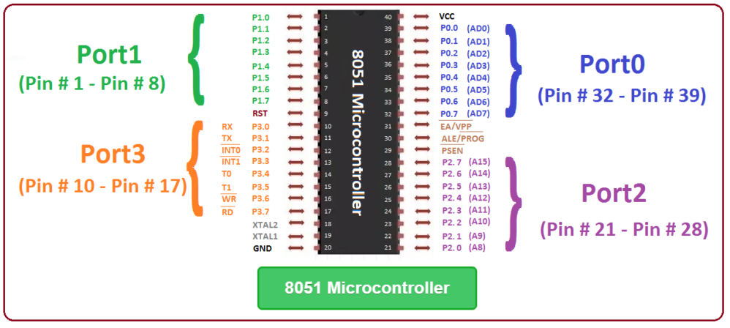
Port Configuration of 8051
Vishwakarma Institute of Technology
FY - Department of Engineering, Sciences and Humanities

Slide 42
Pin description of 8051
Pins 1 to 8 − These pins are known as Port 1. This port doesn’t serve any other functions. Only bi-directional I/O port. Default is o/p.
Vishwakarma Institute of Technology
FY - Department of Engineering, Sciences and Humanities

Slide 43
Pin description of 8051
Pins 32 to 39 − These pins are known as Port 0. It serves as I/O port.
When external memory is being used, it can work as Lower order address bus. Also can work as data bus signals.
Multiplexing can be done on this Port.
Vishwakarma Institute of Technology
FY - Department of Engineering, Sciences and Humanities

Slide 44
Pin description of 8051
Pins 21 to 28 − These pins are known as Port 2. This port serves as I/O port.
But when external memory is used, these pins can work as higher order address bus signals (A8 to A15) thus multiplexing is possible.
Vishwakarma Institute of Technology
FY - Department of Engineering, Sciences and Humanities

Slide 45
Pin description of 8051
Pins 10 to 17 − These pins are known as Port 3. Apart from i/o duties, this port serves some additional functions like ……
3.0 = RXD 3.1 = TXD
3.2 = INT0 3.3 = INT1
3.4 = T0 3.5 = T1
3.6 = WR 3.7 = RD
Most complicated Port !
Vishwakarma Institute of Technology
FY - Department of Engineering, Sciences and Humanities

Slide 46
Pin description of 8051
Pin 9 − It is a RESET pin, which is used to reset the microcontroller to its initial values. Just like a non maskable interrupt. Active high for 2 machine cycles, PC goes to 0000h.
Pin 40 − This pin is used to provide power supply to the circuit (Vcc)
Vishwakarma Institute of Technology
FY - Department of Engineering, Sciences and Humanities

Slide 47
Pin description of 8051
Pins 18 & 19 − These pins are used for interfacing an external crystal to get the system clock.
Pin 20 − This pin provides the power supply to the circuit. (GND)
Vishwakarma Institute of Technology
FY - Department of Engineering, Sciences and Humanities

Slide 48
Pin description of 8051
Pin 30 − This is ALE pin which stands for Address Latch Enable.
Active low pin.
It is used to demultiplex the address-data signal of Port0.
i.e. decide whether to deal with the address or the data.
ALE = 0 → P0 will work as data port
ALE = 1 → P0 will work as address port
(lower 8 bits)
Vishwakarma Institute of Technology
FY - Department of Engineering, Sciences and Humanities

Slide 49
Pin description of 8051
Pin 31 − 8051 has 4 KB on chip ROM and 128 Bytes of RAM.
This is EA pin which stands for External Access input.
It is used to enable/disable the external memory interfacing. Allows CPU to read data from external memories.
When externally held low (EA = 0, GND), allows access to external memory.
If EA = 1 (Vcc), only internal ROM can be accessed.
Vishwakarma Institute of Technology
FY - Department of Engineering, Sciences and Humanities

Slide 50
Pin description of 8051
Pin 29 − This is PSEN pin which stands for Program Store Enable.
It is used to read a signal from the external program memory. Active low pin.
Maximum of 64 KB external ROM can be connected. (Why ?)
Pin 31 (EA) should be made low to get access to the external ROM.
When PSEN (Pin 29) = 0, the external ROM will get activated for its own access and execution.
Vishwakarma Institute of Technology
FY - Department of Engineering, Sciences and Humanities

Slide 51
Port Configuration of 8051
Port no. | Pin nos. | Basic i/o function | Additional features
0 | 32 to 39 | Yes | Lower order address bus and data bus signals can be multiplexed
1 | 1 to 8 | Yes | Nothing – only i/o
Vishwakarma Institute of Technology
2 | 21 to 28 | Yes | Higher order address bus signals can be multiplexed
FY - Department of Engineering, Sciences and Humanities
3 | 10 to 17 | Yes | Can be used for Interrupts, timer input, External memory read and write, serial communication signals like RXD, TXD.

Slide 52
Micro Controllers – 2.2
Basics of 8051
Thanks !
FY – DESH – VIT
Vishwakarma Institute of Technology
FY - Department of Engineering, Sciences and Humanities

